Slide 1



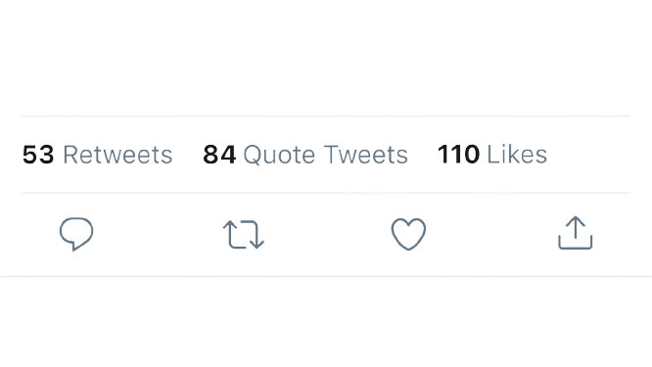
Twitter Blue
Team Utopia 2.0
TECHKRITI 2023
TEAM MEMBERS -
SARTHAK MANDAL
PRANJAL CHAMARIA
DIVYAM GOEL
JATIN SINGLA
MOULIK JAIN
YUVRAJ VERMA

Slide 2

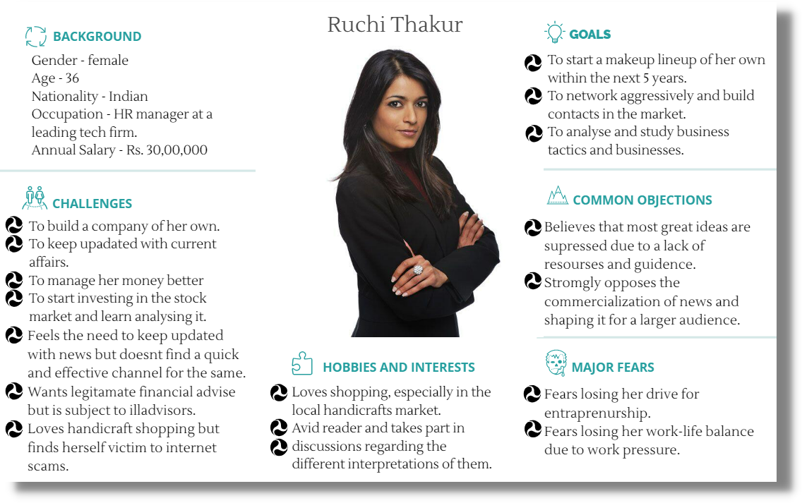

USER ANALYSIS
Buyer Persona
Primary Research
A primary research consisting of the students of our college through google forms implied 90.6% of them found keeping updated with current affairs important but 69.2% find it difficult to do so and 44.9% prefer keeping themselves updated on a weekly basis.
According to survey by EY India, 83% of Indian consumers prefer online shopping due to discounts and offers.
Target Audience
Small
Businesses
Indian Tier 1 -
Tier 2 City
Residents
User Demographics In India
48%
33%
48%
12%
34%
18-35
Age Group
Working
Population
to follow
brands
For
entertainment
Professional
networking
To socialise
to get news

Slide 3



1) Product development
2) Business model
3) Competitive Analysis
4) Marketing strategy
5) Economic feasibility
6) Pricing
7) Risk Management
8) Roadmap
TWITTER NEWS
Given that twitter is a major source of current affairs, we propose to make twitter blue a platform where subscribers get quick access to legitimate current affairs.
The channel deployed will be a short summary video followed by an option to read further or move ahead to the next headline.
The feature will be paired with regulated chatrooms to initiate interactions and discussions like twitter spaces.
"Newsance" - a bot allowing people to create and share related memes, GIFS and stickers.
"TwitterTatter" is a weekly podcast which is a fun and interactive way to summarize the major affairs of the week in a casual setting.
Weekend theme-based crosswords and puzzles to keep audience engaged.
Segregating news into smaller subsections to make the process of finding relevent news much easier and efficient.
CONTENTS
PRODUCT DEVELOPMENT
Our vision for "twitter blue" includes the
following features:
1) Personalised optimized news channel
2) Twitter Blue for Businesses
3) Consult Twitter
4) Improved subscription only features

Slide 4


FEATURE VALUE:
TWITTER BLUE FOR BUSINESSES
Based on our user demographics a large chunk of twitter users browse current affairs on the platform hence enhancing the overall experience on twitter blue will serve as a great value for the users on subscription.
An interactive chatroom will provide for a space for meaningful discussions.
A basic introduction video will provide textual and visual context to current affairs in a quick and effective manner.
The newsance section provides the user a fun way to interact with people and stay updated.
Only verified news will be shown by partnering with leading current affairs suppliers, which prevents the spread of fake and irrelevant news.
With the rise in audio listeners, podcasts will be an effective medium to gain traction from them.
Weekly crosswords and puzzles are a fun way to engage audience.
We propose the sectioning of the platform for businesses and for consumers. This feature is an e-commerce feature that will allow businesses to set up online stores on Twitter, and will enable users to browse, shop and purchase products directly on the platform. Partnering with e-commerce giants in India like Flipkart and Myntra in the setting up of the platform in return for monetary benefits and PR is a great strategy for the quick rolling out of the platform.
Key features -
Blue Verification tick on Twitter giving the company legitamacy.
Better Reach to Targeted Audience through Ads
Permissions for Web Scrapping API
Twitter Galleria for small internet based business owners selling local handicraft.
Free ad-space for the businesses and an exposure to the exisiting 450 million monthly active users.

Slide 5

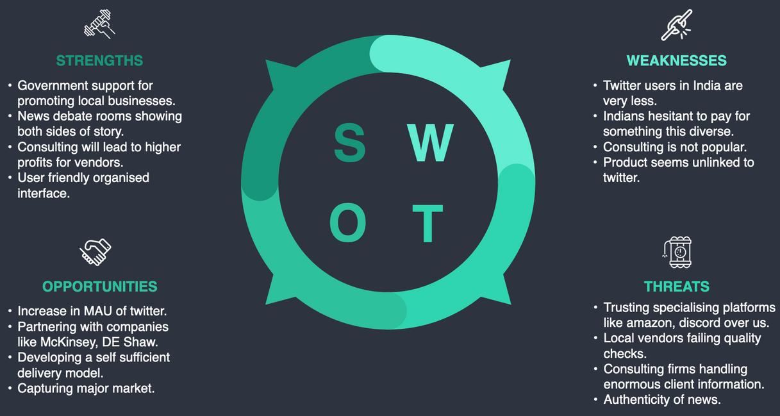
FEATURE VALUE:
CONSULT TWITTER:
India’s clients have been recovering quickly after long COVID. With their ambitions built on new markets, new information and new products, a market for consultancy has been created. Consultancy revenues got a double-digit rebound in almost all sectors, with the overall market growing by 15.2% post -pandemic.
Businesses will go through an verification process to ensure the legitamacy of the products sold. This will reduce skepticism within buyers and prevent scams.
According to a survey released by RedShift Research and GoDaddy, as many as 63 percent of India’s small businesses don’t have their own website, with 40 percent stating that their company is just too small to warrant a website. Twitter Galleria, a part of the platform specifically dedicated for them provides them platform (in form of an online website) for their business along with legitimacy in form of verification.
Thus we present to you "CONSULT TWITTER"!!
IMPLEMENTATION:
For Businesses
For Consumers
In this model a B2B service will be provided to "twitter blue for business" registered companies for a premium from reputated consultancy firms. This is a inititative to attract businesses to join twitter blue.
With B2C style of service, the consumer will get the freedom to choose from a wide choice of verified consultants where twitter blue will act as a middle man. The verified consultants will be generated from company partnerships and twitter blue registered consultancy firms

Slide 6
IMPROVED SUBSCRIPTION
FEATURES:
FEATURE VALUE :
This feature will provide a platform to professionals in various consulting sectors to commercialise their expertise via Twitter.
Users subscribed to Twitter Blue will get access to services from certified consultants at cheaper rates through partnerships with leading firms like upstock and mckinsey.
In order to advertise their expertise, the consultants can post relevant tweets and demo tutorial videos which can be accessed by the Twitter blue users making their choosing process easier.
Twitter drives a 40% greater ROI than other social channels, making it a favourable choice for the consultants looking for partnership with Twitter
The service will spread across all domains of consultancy and not limit itself to financial consulting.
A dislike button for tweets will be provided.
Users can create a thread of replies on tweets. (Inspired by reddit)
While reporting a tweet, customer can write the reason as well in the report.
Disappearing messages feature will be provided in which messages will vanish 24 hours after being sent.
A toggle will be given to turn flags on/off.
Users can follow more than 5,000 accounts.
Users will be able to pin replies on their threads.
Ads will be removed for the customers.
Users can sort the explore page based on filters such as most retweeted, most liked, most disliked, etc.
History of tweets viewed in 24 hours will be made accessible.
Unlimited time and participants will be given for audio chatroom.

Slide 7
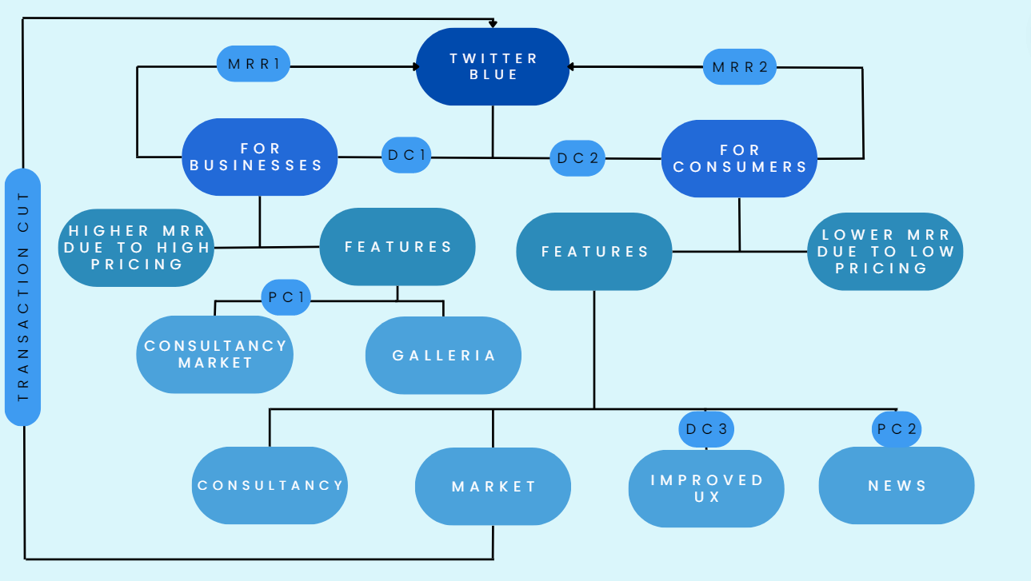

Slide 8




COMPETITIVE ANALYSIS
MAJOR COMPETITORS -
Services Offered
Although no subscription model, the platform serves as a major space for small businesses.
Aggressive socialzing features and extensive provision for discussions.
Presenece of extensive radical opinions on current affairs.
Instagram reels is a fun way of obtaining current affairs.
REDDIT
PREMIUM
Services Offered
A top-notch OTT platform for content streaming.
Additional features in their e-commerce business in form of free quick deliveries and exclusive products.
Ad-free seamless music streaming service
AMAZON
PRIME
INSTAGRAM
Twitter Blue's USP
The subscription model will provide certified news from trusted news channels.
More efficient and organised channel of sharing current affairs.
Small businesses can thrive as they are provided with legitamacy to build trust and consultancy to optimse their functioning.
Regulated group discussions reduces the risk of offending people.
Twitter Blue's USP
Inclusion of businesses within the platform as compared to the B2C service platform of Amazon Prime.
Exclusive Personalisation features.
Providing a platform for small scale businesses to thrive with added aid in form of consultancy.
B2C consulting market
Services Offered
Twitter Blue's USP
Exclusive access to reddit lounge like twitter space.
Removal of all advertisements.
Personalised icons and avatar gear and exclusive awards.
700 reddit coins along with a bonus 1000 coins on subscription
Inclusion of effective and interactive way of conveying current affairs.
Promotion of meaningful discussions by pairing Twitter space with current affairs articles.
Presence of a consultancy market and galleria.
Inclusion of small businesses.

Slide 9

MARKETING STRATEGY AND CUSTOMER AQUISITION PLAN
Advertismement Marketing
Influencer Marketing
Advertisement campain deployed - "product launch campaign"
Advertisement channels - Social media, Google ads, Newspaper,Television as they span across our targetted audience.
Advertisement cost -
Social media - Rs. 382,500 / Platform / Month
Google Ads - Rs. 11 million / Month
Partnership with Newspaper companies for a section in their news consisting crosswords and puzzles based on weekly news summaries aired on Twitter Blue.
Brand Ambassador- Between the brand and the influencer to promote their products or services over a longer period of time - Ex - Ravish Kumar (Youtube Channel) - 30K USD/py.
Affiliate marketing- Influencer promotes the brand's product or service and earns a commission for every sale made through their unique affiliate link. - Partnering with a top tier youtuber - cost: 30K USD/video and almost 1 video per week for 6 months.
Defying Boundaries
Metaverse Marketing
Sponsorship Marketing
Implimentation - Metaverse models of many big events are modelled to provide for an immersive experience of them online. These models can be accessed both using a VR headset and without one. These spaces hence serve as a great ad space witnessing large crowds of popular events.
Partnership cost for big events - Rs. 20.4 Million / event.
Great way to attract the youth and tech enthusiasts.
Implimentation - Similar to the metaverse marketing model, in this section sponsoring popular offline events in India in return for offline marketing.
Partnership cost for big events in India.
Sunburn India - Rs 20 crore for season sponsor
Mood Indigo IIT Bombay- Rs 50 lakh for corporate sposorship

Slide 10

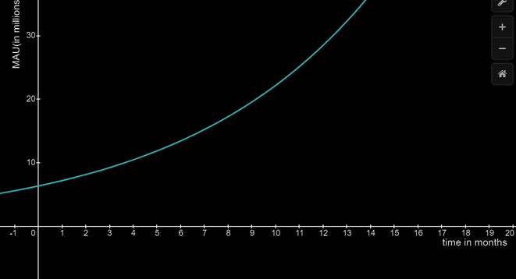
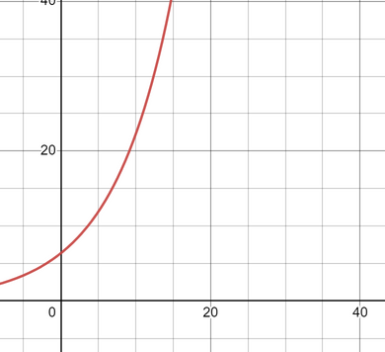

ECONOMIC FEASIBILITY AND PRICING
FEASIBILITY OF USERBASE
BARRIERS TO ENTRY
A great way to determine the feasability of the platform
is predicting the average MAU on the platform 2 years
after it's launch and comparing it to the platform's closest
competitors.
The equation of MAU vs Time (In Months) Plot comes out to be as follows-
MAU(t) = 6.375 (1.133) Million users
The approximation is calculated by compounding an growth rate over a certain time period (T) with 6.375 million initial users.
According to this approximation the total Average MAU after 1 year of launch comes out to be 28.52 Million users. This when comapred to Instagram which aquired 27 Million users 1.5 years after its launch shows the feasibility of userbase in our model.
Analysing the 7 barriers to entry for the platform:
1) Economies of Scale - The exisiting large userbase of twitter mitigates this factor.
2) Product Differentiation - The incorporation of handicrafts market, b2c consultancy service and News on one platform creates a very strong USP.
3) Capital Requirements - Given twitters revenue in q4 of 2021 of
1.47 Billion the initial investment should be covered easily.
4) Switching cost - Justification through value proposition
5) Accessability - Online platform makes it very accessable.
6) Scale Indipendent cost dependence - insufficient data for evaluation.
7) Government Policy - Relatively doesnt effect the platform.
According to this analysis the company is able to overcome them.
T
PRICING
Total number of payments from twitter blue for 6 months is: ∫6.375(1.133)^T.dT from T-0 to T=6 months =56.94 million
For a subsription price of Rs 50,
Total revenue generated from "Twitter Blue" is =50*56.94=₹2847million.
This covers up entire marketing and development cost along with leaving room for operational costs and burn rate.
Hence it is a profitable model with a subscription cost of ₹50.

Slide 11
RISK ANALYSIS
COMPANY TIMELINE
Few of the risks involved with the launch of this
product are:
Twitter at times might face backlash due to controversial news.
Memes newsance can turn homophobic, racist and offensive, hurting the public sentiments.
Competition from already well settled Brands/ e-commerce Platforms.
Twitter would need to ensure that users' payment information and personal data are secure and protected. This would involve implementing secure payment gateways, fraud prevention measures, and data protection protocols.
Twitter would need to find a way to monetize the shopping feature, either through commissions on sales or through advertising, without alienating its users or making the shopping experience too intrusive.
This feature may not entice the users who use Twitter for leisure and entertainment
Low quality services from a few consultants may result in depreciation in company’s name and reputation.
1 Month after launch
6 Months after launch
Gather and analyse data from ads but do not make changes in ad account.
Total estimated MAU: 7.22 million
Shorten the sales cycle by approaching the decision maker through email lists and webinar.
200-300 estimated keyword clicks per month
Increase ad quality score
Total estimated MAU: 13.48 million
Expected to breakeven
3 Months before launch
3 Months after launch
1 Year after launch
Pre-launch advertisement
Optimize negative keywords and keyword bids based on the collected data.
Total estimated MAU: 9.27 million
Make sure ad quality score is between 8-10.
Neglect non-profitable marketing channels.
Improve experience
Total estimated MAU: 28.52 million

Slide 12

www.reallygreatsite.com

